Slide 1

Network Programming
Charly Dang
Tsend-Ayush Batbileg

Slide 2
Socket Programming
Connecting two nodes to a network
One node listens on a particular port at an IP
One node reaches out to the other
import socket # Python socket library
s = socket.socket(socket.AF_INET, socket.SOCK_STREAM)
Notes:
Sockets allow communication between two different processes on the same or different machines. For socket programming in python, you simply import the socket library.

Slide 3
import socket
Mac OS X
Windows
Unix
BeOS
OS/2
Notes:
The socket library is supported for most of the popular operating systems.

Slide 4
Socket Addresses
AF_INET : refers to the address family ipv4
(host, port)
host: 100.69.42.0 ← Domain notation or IPv4 address
Port: 9999 ← Integer
SOCK_STREAM : connection oriented TCP protocol
Notes:
s = socket.socket(socket.AF_INET, socket.SOCK_STREAM)

Slide 5
HOST, PORT = "Localhost", 9999
s = socket.socket(socket.AF_INET, socket.SOCK_STREAM)
s.bind((HOST, PORT))
s.listen(1)
Notes:
In our project, we used localhost and port 9999 as the default. Here we created the socket object and we are calling the bind method and the listen method. Each of these method calls will be explained

Slide 6
s = socket.socket(socket.AF_INET, socket.SOCK_STREAM)
socket.socket([family[,type[,proto]]])
Creates a new socket using the address family
Default family is AF_INET but AF_INET6 or AF_UNIX are valid too
SOCK_STREAM
Socket type.
Protocol number is usually 0 and can be omitted if its 0

Slide 7
socket.bind((HOST,PORT))
socket.bind(address)
Binds the socket to address
Accepts tuple

Slide 8
socket.listen(backlog)
Specifies the number of queued connections
Minimum value is 0
Maximum value is 5
Notes:
Since our game is a turn based game, we only need to listen for 1 connection

Slide 9
socket.recv(buffersize[,flags])
Buffersize : maximum number of data to be received at once
Notes:
This is an important function. The recv method received the data. In our project, its defined as 1024 or 1K

Slide 10
socket.sendall(string[,flags])
Send data to the socket
Continues to send data until all data has been sent or an error occurs
socket.send(string[,flags])
Sends the string but it might not send all of the string
Notes:
To make communication possible, we also use the sendall method to send the status of the game. There is a another method send but there is a chance that not all of the data is transmitted at once.

Slide 11
socket.close()
Closes the socket
If not closed, all future operations on the socket object will fail
Releases the resource associated with a connection but doesn’t close the connection immediately.
To close the socket immediately call shutdown() before close()

Slide 12
Try:
while True:
data = conn.recv(1024).decode()
moves = moves+1
choices[int(data)-1] = 'O'
printBoard(choices)
Notes:
Code in context, just a code snipplet

Slide 13
Tic Tac Toe
Represented as 3x3 matrix
Internally represented as a list
Game is won if a player has three matching slots diagonally, horizontally or vertically

Slide 14
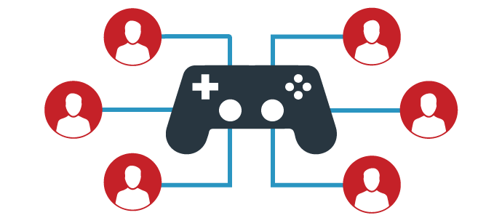
Game Networking
Multiplayer games consist of two more more players
Share consistent experience across the network
Sleight-of-hand
Notes:
Multiplayer can seem magical from the outside: two or more players sharing a consistent experience across the network like they actually exist together in the same virtual world
What we perceive as a shared reality is only an approximation unique to your own point view and place in time

Slide 15
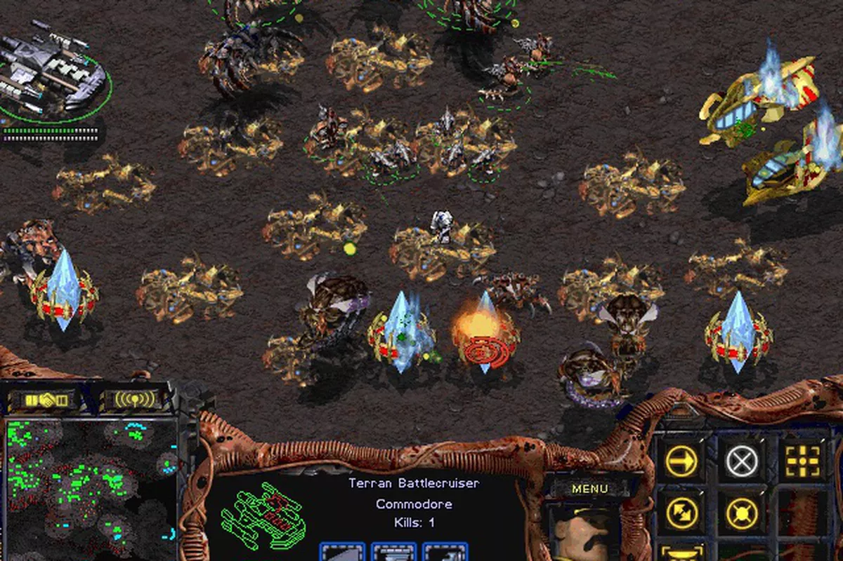
Peer-to-Peer Lockstep
Early games were networked peer-to-peer
Basic idea: abstract the game into a series of turns and choices that direct the flow of the game
RTS games like still use this model:
Command and Conquer
Age of Empires
Starcraft
Cons: Must start at same initial state, must play out identically on each machine

Slide 16

Client/Server
Action games like Doom showed the massive downside of Peer-to-Peer
Before you could act out a command(move, shoot) you had to wait for inputs from the most lagged modem player
Players were categorized as “client” which communicated to one computer known as the “server”
Game only existed on the server, clients only sends inputs such as key presses, mouse movement and clicks
Cons: latency

Slide 17

Client-Side Prediction
Latency issues in early game like Quake
To remove latency, client runs more code than previous
It is able to predict the movement of your character locally and immediately
Difficulty exists in applying the correction back from server
To pan out differences between server and client, we use a circular buffer of past character state and input for the local player on the client
Notes:
https://gafferongames.com/post/what_every_programmer_needs_to_know_about_game_networking/

Slide 18

Thank You

